Slide 1
Presentation on online mobile shop
Md. Abu Jafor

Slide 2

ABOUT THE PROJECT

Slide 3
TABLE OF CONTENTS
01
02
03
Sign up & log in
Copmany list
Phone list

Slide 4
TABLE OF CONTENTS
04
05
06
Promo codes
confermation
customer information

Slide 5
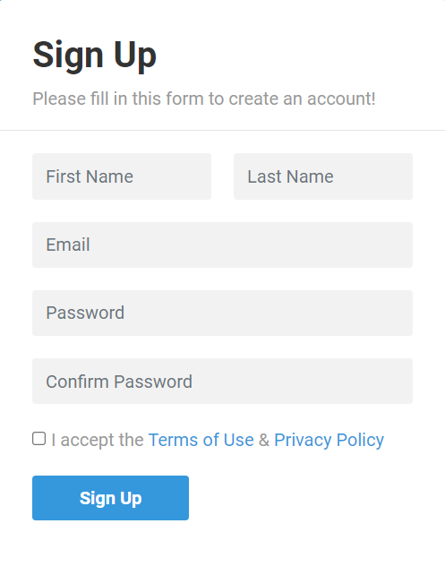
Sign up
Input your information

Slide 6
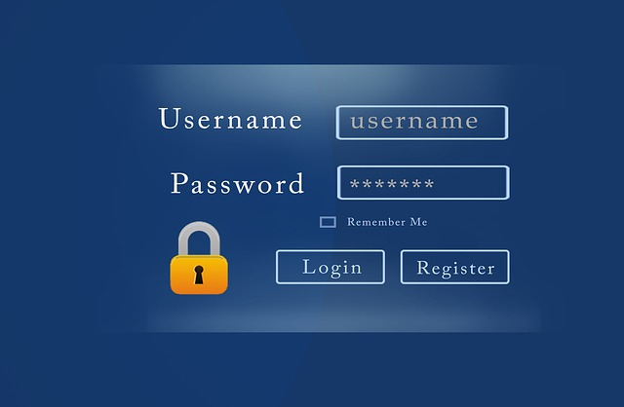
Log in

Slide 7
Company list
1. SAMSUNG Bangladesh 2. Xiaomi Mobile Bangladesh 3. Realme Mobile Bangladesh 4. Walton Mobile Bangladesh

Slide 8
1. Xiaomi Mi 11 Lite 2. Xiaomi Redmi Note 8 (2021) 3. Xiaomi Redmi Note 10 4. Xiaomi Poco M2 Pro 5. Xiaomi Poco M3 6. Xiaomi Redmi 9
PHONE LIST OF XIAOMI

Slide 9
Promo codes
Get 5% discount (AHC05)
Get 10% discount (AHC10)
Get 15% discount (AHC15)

Slide 10
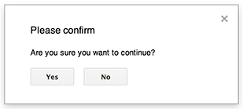
confermation
Purchase Confirm
1.Yes
2.No

Slide 11
customer information
Buyer Info:
Name : Ariyan
Location: Dhaka
Mobile No: 017********
Thanks for being part of our family

Slide 12
ExpLANTION of our code
Please see our Codeblocks.

Slide 13
THANKS!
Do you have any questions?

